Slide 1
19th Century Novel:
The Strange Case of Dr. Jekyll and Mr. Hyde
GCSE English Literature – THE NIGSTER (EDUCATION FOR THE NATION) tm

Slide 2
Unit Assessment Objective Focus
AO1
Read, understand and respond to a text.
Maintain a critical style and develop an informed personal response
Use textual references, including quotations, to support and illustrate interpretations.
AO2
Analyse the language, form and structure used by a writer to create meaning and effects, using relevant subject terminology where appropriate.

Slide 3
Students will be able to:
Week 1
  Begin to gain an understanding of the:
    The main characters, their personalities and backgrounds.
    the language used by the writer to create meaning and effect.
    The relationships between characters and how they might develop.
Weeks 2
  Understand themes of the whole text and make predictions about their development.
  Explore aspects of plot, characterisation, events and settings.
  Develop informed and thorough understandings of the different characters and their relationships.
    Week 3
  Understand the ways in which themes and characters develop as the text progresses.
  Understand the narrative structure and genre of the text.

Slide 4
Students will be able to:
Week 4
  Identify key features of the text’s form, structure, and language and be able to explain their effect.
  Produce clear and coherent responses, selecting and emphasising key points.
  Select relevant and effective quotations to support a point of view.
Week 5
  Become aware of key terms and phrases in exam questions.
  Develop and informed personal response.
  Use textual references, including quotations, to support and illustrate interpretations.
  Complete timed responses to sample exam questions.

Slide 5
Exam Facts
Length: 2 hours and 15 minutes
Closed book (texts are NOT allowed in examination)
This exam is worth 50% of your total Literature GCSE
Section A – 19th century novel: Students will complete a two part question.
  Part 1 – focussed on a close language analysis of an extract of approximately 400 words. (AO2 - 20 marks)
  Part 2 – questions may focus on different aspects of the text, requiring exploration of one or more of the following areas: plot, setting(s), character(s), theme(s). (AO1 - 20 marks)
Section B – Poetry since 1789

Slide 6
Lesson - Background and Context
Learning Question
What are some of the main themes of the novel and how do they link to the time period this novel was written in?

Slide 7
Jekyll and Hyde
From the novel’s title, the phrase ‘Jekyll and Hyde’ has slipped into common English usage.
But what does it mean? Discuss the following:
What does the phrase usually refer to? An object, a place or a person?
What do you understand by the phrase ‘a Jekyll and Hyde’ personality’?
Can you think of a fictional character from a novel, film or TV show that has a ‘Jekyll and Hyde’ personality?

Slide 8
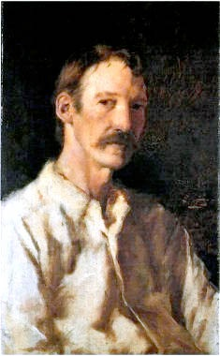
Who is Robert Louis Stevenson?
Robert Louis Balfour Stevenson (13 November 1850 – 3 December 1894) was a Scottish novelist, poet, essayist, and travel writer of the Victorian era. His most famous works are Treasure Island, Kidnapped, and the Strange Case of Dr Jekyll and Mr Hyde.
Stevenson was a very poorly child who read a great deal about travel and adventure. A combination of his love of adventure and ill health led him to spend many years as a writer travelling the world in search of a climate that was healthier than Britain's.
Stevenson was influenced by the work of Edgar Allan Poe and Charles Dickens and wrote in a range of genres including adventure, historical and horror.

Slide 9
A little bit about Context
The novel will make far more sense if you know a bit about that period in history.
Why might it be important to understand what was going on during the time period this novel was written?
How might it impact our understanding of the characters, plot and language?

Slide 10
Victorian Gentlemen
The ‘gentleman’ was an important figure in Victorian society.
A man’s social class was one part of being a gentlemen – gentlemen were from the upper-classes of Victorian society.
Gentlemen were expected to have strong morals and be kind, particularly towards poorer people. But plenty of people saw this as a less important part of being a gentleman.

Slide 11
The Reputation Obsession
Gentlemen were determined to maintain their reputations – without a good reputation, a man couldn’t be considered a gentleman at all.
Gentlemen were expected to keep their emotions under strict control. This forced them to hide their desires for things like alcohol, gambling and sex.
Many gentlemen were publicly snobbish about disreputable places, like public houses and brothels, whilst visiting them secretly at night.
They were prepared to pay large sums of money to keep such activities private, which makes them vulnerable to blackmail.

Slide 12
Victorian London
Victorian London wasn’t all gentlemen in top hats and tails. Whilst the middle and upper-classes lived in richly-furnished houses, this wasn’t true of everyone.
The Industrial Revolution meant that many working-class people migrated to large cities to live and work.
Housing had to be built rapidly, resulting in poor quality housing and slums in an area known as Soho.
The streets in the slums were narrow and poorly lit. Victorian London was known for its smoke, caused by burning coal on a large scale.

Slide 13
Disrespectable Working-Class
There were some parts of London where most respectable men wouldn’t want to be seen, such as the working-class slums. They also wouldn’t want to be seen visiting brothels or public houses.
The two sides of the city – upper-class and working-class – did overlap. Some gentlemen would deliberately travel to the ‘dismal’ areas of London (where there was less chance of being recognised) to satisfy the desires they hid in public.

Slide 14
Religion versus Science in the 19th century
Like many writers of the late 19th Century, Stevenson was greatly influenced by Charles Darwin’s The Origin of Species published in 1859. This groundbreaking book introduced the Theory of Evolution in which Darwin put forward the theory that all life has evolved over millions of years. The book was (and still is) very controversial and many saw it as an attack on religion.
This was a time when science and religion were beginning to appear very much at odds with each other and many people felt they had to choose between the two.
There was also a concern amongst religious people that science was becoming dangerous and was interfering in matters which only God had control over

Slide 15
Nature versus the Supernatural
In the Victorian era there is emerging the idea that humanity itself is in constant conflict.
On the one hand, people lead calm, rational, everyday lives, but on the other hand, a darker side of humanity exists where sexual fantasies, nightmares, violence and murder dwell. It was the rational versus the irrational; nature versus the supernatural; good against evil.
This duality of human nature is the main theme of the novel.
The infamous Jack the Ripper murders occurred in London in the 1880s which seemed to reinforce the Jekyll and Hyde duality of human nature, especially as the evidence suggested that the murderer was an educated and ‘respectable’ man.

Slide 16
Lesson – Character Breakdown
Learning Question
What do we learn about the characters of Utterson, Enfield and Hyde in chapter one?

Slide 17
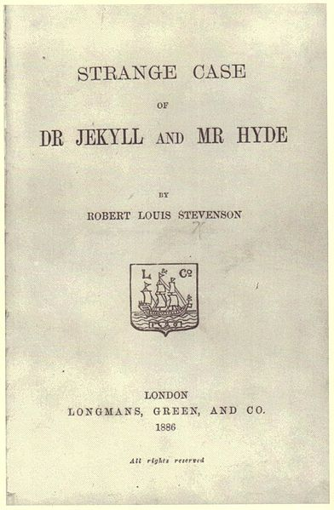
Predictions
Examine the cover of Dr Jekyll and Mr Hyde. Consider the title and author, study any illustrations and read the blurb. What can you deduce about the setting, plot and genre of the story?

Slide 18
Learning the Lingo – 4 minutes
Before we read the first chapter, lets take a look at some of the language that will be used.
With a partner, complete the Chapter 1 Mix-n-Match vocabulary worksheet.
Don’t leave anything blank, use a dictionary or guess based on the root of the word.
Notes:
Worksheet in 19th Century SOW file on English Staff Drive

Slide 19
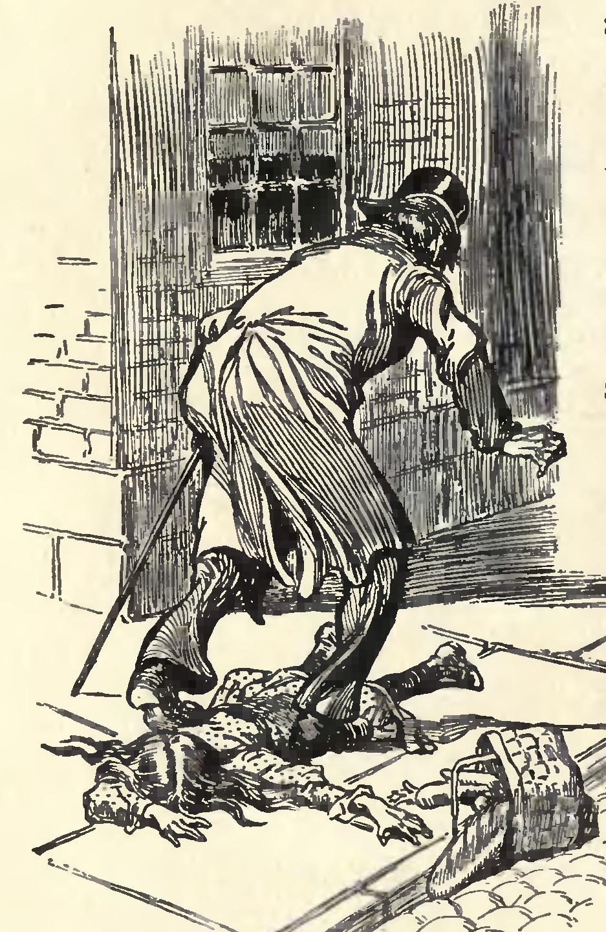
Reading
Read and discuss Chapter 1, Story of the Door.
Pay close attention to the characters of Utterson, Enfield and Hyde and the language used.
Notes:
Image: http://commons.wikimedia.org/wiki/File:Jekyll.and.Hyde.Ch1.Drawing2.JPG
DescriptionEnglish: Artwork by Charles Raymond Macauley for the 1904 edition of The strange case of Dr. Jekyll and Mr. Hyde by Robert Louis Stevenson. Publisher: New York Scott-ThawDate1904SourceThe strange case of Dr. Jekyll and Mr. Hyde. Illustrated by Charles Raymond Macauley (1904). http://www.archive.org/details/strangecaseofdr00stevuoftAuthorCharles Raymond Macauley (1871 - 1934)

Slide 20
What to look for
Remember the three techniques authors use to create characters.
Description
Dialogue
Action
These are known as literary devices, they are the tools used by writers to make characters come alive.
Look out for these techniques when we are introduced to new characters in the story.
Copyright 2013 Online Teaching Resources Ltd

Slide 21
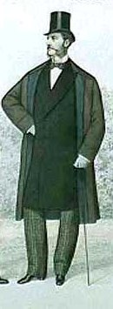
Mr Utterson
What are your first impressions of Mr Utterson? Find words or phrases to describe him.
Copyright 2013 Online Teaching Resources Ltd
Notes:
Image: http://commons.wikimedia.org/w/index.php?title=Special%3ASearch&profile=default&search=victorian+man&fulltext=Search&uselang=en

Slide 22
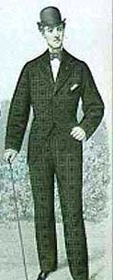
Mr Enfield
Now make notes about Mr. Enfield. How is he similar and different to Utterson? How would you describe him?
Copyright 2013 Online Teaching Resources Ltd
Notes:
Image: http://commons.wikimedia.org/w/index.php?title=Special%3ASearch&profile=default&search=victorian+man&fulltext=Search&uselang=en

Slide 23
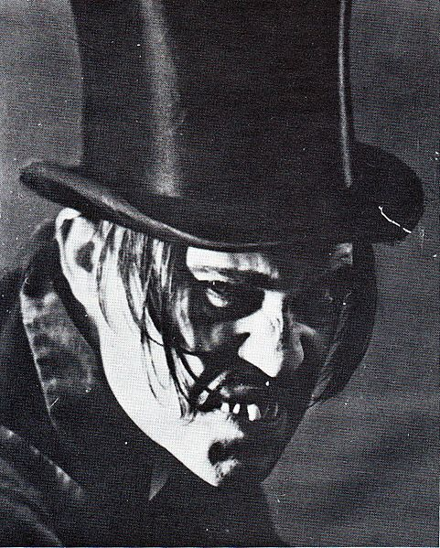
Mr Hyde
What are your first impressions of Mr Hyde? How does the author use description, dialogue and action to convey his character?
Copyright 2013 Online Teaching Resources Ltd

Slide 24
Task: Language and Characters
Choose either Utterson or Enfield and a minimum of 2 words Stevenson used to describe them in chapter one. Write a PEAL paragraph examining what these words tell the reader about the character and why Stevenson might have chosen those words. Remember to consider what impact these words have on the reader and what connotations may exist.

Slide 25
Lesson - Language
Learning Question
How does Stevenson use contrasting language in the novel to create effect?
What do we learn about the character of Hyde?
Key Words:
  Endorse, decease, benefactor, protégé, conveyance, labyrinths, inordinate, condone, iniquity, troglodytic.

Slide 26
Contrasting Language
In Chapter 1 the reader is introduced to three contrasting characters – Mr Enfield, Mr Utterson and Mr Hyde. These men represent different types of people. Enfield is a rather shallow ‘man about town’ who chooses not to think about unpleasant things too much as it upsets his view of the world. Utterson is a much more thoughtful man than Enfield. He is rational and scientific and ‘a lover of the sane and customary sides of life'. He is very much representative of the average reader of the Victorian era. In stark contrast is Mr Hyde - a violent, immoral and secretive man who strikes fear into the hearts of others.
Contrast is not only used to compare the people but also the places in the story. Consider the description of London in Chapter 1 as Enfield and Utterson walk the streets in the opening pages. Discuss the following questions:
How does Stevenson use contrast to describe the city streets?
What could Stevenson be saying about London?
How does the building Hyde entered contrast with its surroundings?
How can contrast create mood?
How can contrast convey theme?
Copyright 2013 Online Teaching Resources Ltd

Slide 27
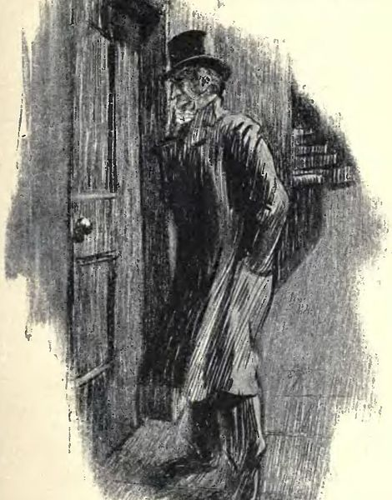
Reading
Read and discuss Chapter 2, Search for Mr Hyde.
Pay close attention to the characters of Utterson and Hyde and how they contrast one another.
Copyright 2013 Online Teaching Resources Ltd

Slide 28
Build on what we know
Using what you’ve learned from chapter 2, add to the character descriptions we created for Utterson and Hyde in the last lesson.
What words could we add?
Has your opinion of these characters changed or stayed the same in this chapter?

Slide 29
Task: Examining key characters
Using your knowledge of description, dialogue and action write a PEAL paragraph explaining how Stevenson presents the character of Mr Hyde to the reader.
You could use some of the sentence starters on the next slide to get you up and running.

Slide 30
Sentence starters
Mr Hyde
The first thing we learn about Mr Hyde is that he is...
He is described as …
The way he speaks tells the reader that…
The way he (action) reveals…

Slide 31
Extension – writing about setting
Use these sentence starters to write a paragraph about the setting.
The Setting
The story is set in ... The city is presented as a place of great …
In places Stevenson describes the city as …
This creates the impression of a _____ and _____ place.
However the author also describes a _____ side to the city.
In Chapter 1 Enfield and Utterson pass through streets described as …
This paints a very different picture and reveals a _____ and _____ environment.
Stevenson does this to show …

Slide 32
Lesson – Character Analysis
Learning Question
Who is Henry Jekyll and what is his connection to Hyde?
Key Words:

Slide 33
Before we go any further....
Chapter | Setting | Characters | Key events | Key quotes
1
2
3
4
5
6
7
8
9
10
This table will help you keep track of the main events of the story. Copy it into your workbooks then complete chapters 1 & 2. Leave yourself plenty of room for each chapter.

Slide 34
Keep your eyes open...
In the next few weeks we are going to begin closely examining key themes in the novel.
As we read through the chapters keep your eyes open for references to the importance of reputation, the dual nature of man, science and religion, and secrecy.

Slide 35
Learning the Lingo – 4 minutes
Before we read the third chapter, lets take a look at some of the language that will be used.
With a partner, complete the Chapter 3 Mix-n-Match vocabulary worksheet.
Don’t leave anything blank, use a dictionary or guess based on the root of the word.
Notes:
Worksheet in 19th Century SOW file on English Staff Drive

Slide 36
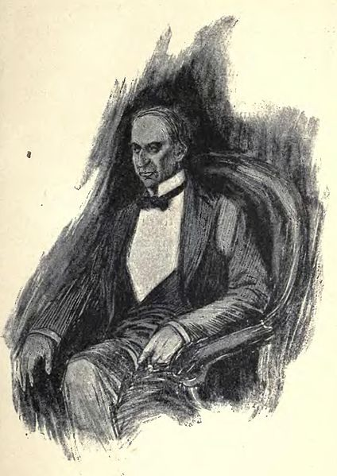
Reading
Read and discuss Chapter 3, Dr. Jekyll was Quite at Ease.
Pay close attention to the presentation of the character of Dr. Jekyll.
Copyright 2013 Online Teaching Resources Ltd

Slide 37
Dr. Jekyll
What are your initial impressions of Dr. Jekyll? Jot down words or phrases to describe him.
Copyright 2013 Online Teaching Resources Ltd

Slide 38
Task: Examining the Good Doctor
Using your knowledge of description, dialogue and action write a PEAL paragraph explaining how Stevenson presents the character of Dr. Jekyll to the reader.
You could use some of the sentence starters on the next slide to get started.

Slide 39
Sentence Starters
Dr Jekyll
The first thing we learn about Dr. Jekyll is that he is...
He is described as …
The way he speaks tells the reader that…
The way he (action) reveals…

Slide 40
Lesson – Extract Analysis
Learning Question:
  How can we breakdown an extract and thoroughly explain our understanding of the characters based on the information we have?
Key Words:
Constitution, incipient, idiosyncratic, misbegotten, transcendental, turpitude, penitence

Slide 41
Who’s who?
Match up the description with the character
Mr Enfield
a lawyer and old friend of Dr. Jekyll
Mr Utterson
a wealthy doctor know for being experimental and erratic
Dr. Jekyll
a small, vicious and violent man
Dr. Lanyon
a well-known man about town and the complete opposite to Utterson
Mr Hyde
Dr. Jekyll’s butler
Poole
a conventional and respectable doctor

Slide 42
Putting what we know to work
On the following slide there is an extract taken from ’Search for Mr. Hyde.’
Read and annotate the extract carefully and then begin to think of answers for the below question.
‘From this extract, how is the character of Mr. Utterson presented?’

Slide 43
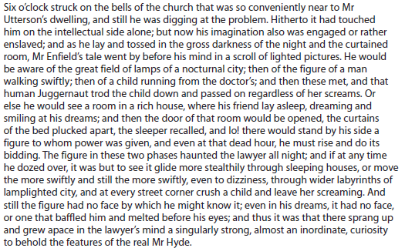
‘From this extract, how is the character of Mr. Utterson presented?’
Notes:
Print out a copy for each student to stick into their books to work with while you model extract annotation.

Slide 44
Write your response
Using the annotations we just did of the extract, write a response to the given task.
Keep in mind that a character is presented through their actions, dialogue and description.

Slide 45
Homework:
Read Chapter 4, The Carew Murder Case.
Pay close attention to the descriptions used by Stevenson.

Slide 46
Lesson – Symbolism & Consolidation
Learning Question:
  How has Stevenson used symbolism in the novel?
  Do I understand the plot and language of the novel so far?
Key Word:
  Symbolism

Slide 47

Look at the symbols below, do you know what they represent?
How do we know what these mean?
Can you think of any other symbols that might be familiar with?

Slide 48
Symbolism
A symbol is something that represents specific ideas or themes. There are a number of symbols in Dr. Jekyll and Mr Hyde.
Dr. Jekyll’s house is the first symbol used by Stevenson in the novel.
How is it described in Chapter 1?
How is the front of the property different to the back?
Who uses the front door?
Who uses the back door?
What do you think the house symbolises?
In Chapter 1, the house, seen from the rear, is ugly and neglected.
From the front the house looks like a respectable home for a wealthy Victorian doctor.
Dr. Jekyll uses the front door.
Mr Hyde has been seen using the back door.
The house could symbolise good and evil. From the front all appears pleasant and attractive but behind this veneer lies a dark, secretive and unpleasant place.

Slide 49
Chapters 1-4 Consolidation Questions
What is Mr Utterson’s job? What does this suggest about him?
How do people react to Mr Hyde?
How are Dr. Jekyll and Dr. Lanyon different?
Who is Poole?
What two crimes has Hyde committed by the end of Chapter 4?
Where does Hyde live?
How was this part of London different to the rest of the West End in Victorian times?
The word ‘hissing’ is used to describe Hyde’s speech. What does this word compare Hyde to?
Why would this be significant?
What document is Utterson keeping for Dr. Jekyll?
What worries him about it?
What does the word ‘sawbones’ mean?
What does Dr. Jekyll say to Mr Utterson about Hyde at the end of Chapter 3?
What is discovered when Utterson and the police visit Hyde’s house in Chapter 4?

Slide 50
Lesson – Character Juxtaposition
Learning Question:
  How do Jekyll and Lanyon contrast one another?
  Why did Stevenson choose to present these two characters as such opposites?
Key Words:
  Cabinet, qualm, oration, sedulously, amities, melancholy, superscribed, disquieted

Slide 51
Fill in chapters 3-4 of your chart
Chapter | Setting | Characters | Key events | Key quotes
1
2
3
4
5
6
7
8
9
10

Slide 52
Reading
Read chapters 5 and 6, Incident of the Letter and Remarkable Incident of Dr Lanyon and discuss the following:
What has happened to Hyde?
How is Dr. Jekyll different?
What has happened to Dr. Lanyon?
What does Lanyon say is the cause of his illness?
What does Lanyon leave for Utterson?

Slide 53
Before and After
In chapter six we meet a very different Dr. Lanyon. How has Lanyon changed since Utterson last saw him?
Before he saw Jekyll | After he saw Jekyll
Why do you think Stevenson includes this character?
What does he represent?
Copyright 2013 Online Teaching Resources Ltd

Slide 54
Before and After
In chapter six we meet a very different Dr. Lanyon. How has Lanyon changed since Utterson last saw him?
Why do you think Stevenson includes this character?
What does he represent?
Before he saw Jekyll | After he saw Jekyll

Slide 55
Dr. Lanyon and Dr. Jekyll
The two doctors are poles apart. How does Stevenson convey this difference to the reader? Complete the table below.
Dr. Lanyon | Dr. Jekyll

Slide 56
Lesson – Mystery
Learning Question:
  How is mystery created in Dr. Jekyll and Mr. Hyde?

Slide 57
Who, what, where?
Who said “I’ve been wanting to speak to you”
Who said “I trust before any man alive”
Who said “My position is very strange”
What did Jekyll make Hyde promise?
Where did the whole scene take place?
Challenge Point: select a quotation that shows the change in the atmosphere

Slide 58
Let’s read the extract
Skim read the text a second time and select at least 3 quotations that give a sense of MYSTERY
Any thing vague, secret or unexplained

Slide 59
Extract
[Jekyll] ‘O, I know he’s a good fellow – you needn’t frown – an excellent fellow, and I always mean to see more of him; but a hide-bound pedant for all that; an ignorant blatant pedant. I was never more disappointed in any man than Lanyon.’
‘You know I never approved of it,’ pursued Utterson, ruthlessly disregarding the fresh topic.
‘My will? Yes, certainly, I know that,’ said the doctor, a trifle sharply. ‘You have told me so.’
‘Well, I tell you so again,’ continued the lawyer. ‘I have been learning something of young Hyde.’
The large handsome face of Dr Jekyll grew pale to the very lips, and there came a blackness about his eyes. ‘I do not care to hear more,’ said he. ‘This is a matter I thought we had agreed to drop.’
‘What I heard was abominable,’ said Utterson.
‘It can make no change. You do not understand my position,’ returned the doctor, with a certain incoherency of manner. ‘I am painfully situated, Utterson; my position is a very strange – a very strange one. It is one of those affairs that cannot be mended by talking.’

Slide 60
Extract continued
‘Jekyll,’ said Utterson, ‘you know me: I am a man to be trusted. Make a clean breast of this in confidence; and I make no doubt I can get you out of it.’
‘My good Utterson,’ said the doctor, ‘this is very good of you, this is downright good of you, and I cannot find words to thank you in. I believe you fully; I would trust you before any man alive, ay, before myself, if I could make the choice; but indeed it isn’t what you fancy; it is not so bad as that; and just to put your good heart at rest, I will tell you one thing: the moment I choose, I can be rid of Mr Hyde. I give you my hand upon that; and I thank you again and again; and I will just add one little word, Utterson, that I’m sure you’ll take in good part: this is a private matter, and I beg of you to let it sleep.’

Slide 61
Analysis
Change of topic from Jekyll
Word choice: ruthlessly dismissing/
Jekyll growing pale- noticed by Utterson Deep hidden secret
Darkening of eyes- suggests opened wide in horror/ fright
Jekyll halting conversation- hesitant to give any information
Jekyll does not want to be reminded of the incidents
“You do not understand my position” Jekyll wants to tell his friend but cannot
Incoherent- stunned/ blabbing/ rushing of words/ faulting/ pauses
“My position is very strange” unable to tell him? Would be believe him? Cannot trust Utterson with the truth- withholding information
Jekyll’s reassurance does nothing but raise more suspicions
“I can be rid of Hyde” mysterious

Slide 62
Quotation | How it creates MYSTERY
‘My will? Yes, certainly, I know that,’ said the doctor, a trifle sharply”
‘my position is a very strange – a very strange one.’
‘I would trust you before any man alive, ay, before myself’
“Grew pale”
“eyes darken”

Slide 63
Quotation | How it creates MYSTERY
‘My will? Yes, certainly, I know that,’ said the doctor, a trifle sharply” | The sharpness in Jekyll’s tone suggest his annoyance. He has tried to start a new subject but Utterson has deliberately dismissed it.
‘my position is a very strange – a very strange one.’ | Jekyll is incredibly reluctant to share his ‘position’ with Utterson and describes it as strange. Jekyll is being deliberately vague and unclear, he wants to tell his friend but cannot
‘I would trust you before any man alive, ay, before myself’ | Jekyll reassures Utterson that he trust him implicitly, yet he still does not share his ‘position’ with Utterson.
“Grew pale” | Utterson notices this reaction. It could suggest a deep hidden secret.
“eyes darken” | This could suggest that his eyes are opened wide in horror/ fright

Slide 64
Homework
In a PEAL paragraph, answer the question:
HOW HAS MYSTERY BEEN CREATED IN THE EXTRACT?

Slide 65
Lesson – Pathetic Fallacy
Learning Question:
  How has Stevenson used language and writing techniques, specifically pathetic fallacy, to effect?
Key Words:
  Pathetic fallacy, disconsolate, abject, traversed, doggedly, lamentation, sedulous, mottled pallor, malefactor, disinterred.

Slide 66
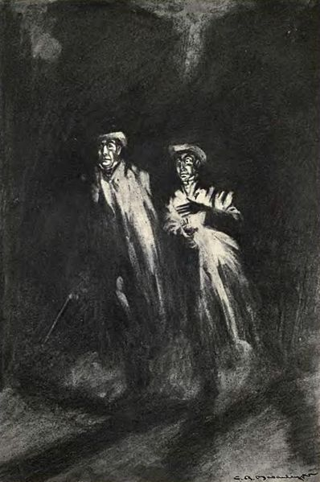
Reading
Read up to the end of chapter 8.
What happens?
What is the weather like?

Slide 67

What is pathetic fallacy?
Pathetic fallacy is a form of personification where aspects of the environment or atmosphere are given human characteristics or reflect human emotion.
It is used in many art forms. Painters, writers and film makers all use pathetic fallacy to create mood, express a theme or build tension.
For example, in a film the weather may reflect the character’s emotions. This is pathetic fallacy.
Some examples are shown on the following slide…

Slide 68


Pathetic Fallacy
Click
The Hitcher
Lord of the Rings – The finale
Lord of the Rings – Rohirrim Battle
Titanic
Notes:
Click on the images below to watch 5 movie clips. Explain how the film makers use pathetic fallacy in each scene.

Slide 69
Pathetic Fallacy
Movie clip | Weather | Effect created
Click | Heavy rain | Creates an appropriately poignant and sombre mood as the character dies.
Lord of the Rings battle scene | Dark storm clouds | Adds a dark mood and a sense of foreboding.
Lord of the Rings ending | Bright, golden sunset | Sunlight suggests hope and optimism at the end of a movie filled with dark scenes.
The Hitcher | Thunder, lightening, heavy rain | Builds suspense and helps to establish a tense, nerve-jangling atmosphere.
Titanic | Beautiful sunset | Creates a romantic backdrop fitting for two characters falling in love.

Slide 70
Pathetic fallacy in literature
Re-read the opening few pages of Chapter 8.
What is the weather like?
How does it create mood and atmosphere?
How does it emphasise the character’s emotions?
How does it provide hints about the plot?

Slide 71
Pathetic Fallacy Task
Write a PEAL paragraph explaining how Stevenson uses pathetic fallacy in Chapter 8 of Dr Jekyll and Mr Hyde.

Slide 72
Lesson – Lanyon’s Narrative
Learning Question:
  What role does Dr. Lanyon play in the novel?
Key Words:
  Whetted, enigmas, flighty

Slide 73
Fill in Chapters 5, 6 & 7 of your chart
Chapter | Setting | Characters | Key events | Key quotes
1
2
3
4
5
6
7
8
9
10

Slide 74
Reading
Read to the end of Chapter 9, Dr Lanyon's Narrative and discuss the following:
What did Jekyll ask Lanyon to do?
Who does Lanyon meet at midnight?
What does Lanyon witness?
How does this affect Lanyon?
What is Lanyon’s role in the story?

Slide 75
Lanyon’s Narrative
Place the events of Lanyon’s narrative in the correct order
Dr Lanyon invites the visitor in.
The man screams and staggers around Lanyon’s home.
Lanyon realises that Jekyll and Hyde are the same person
The man is dressed very strangely and acts in a peculiar manner.
Lanyon receives a letter from Jekyll asking him to collect a drawer containing chemicals, a vial and a notebook from Jekyll's laboratory and to give it to a man who would call at midnight.
The man hurriedly drinks the potion.
At midnight, a messenger from Dr. Jekyll knocks on Dr. Lanyon’s door.
The man transforms into Dr. Jekyll before Dr. Lanyon’s eyes.

Slide 76
Lanyon’s Narrative
Lanyon receives a letter from Jekyll asking him to collect a drawer containing chemicals, a vial and a notebook from Jekyll's laboratory and to give it to a man who would call at midnight.
At midnight, a messenger from Dr. Jekyll knocks on Dr. Lanyon’s door.
Dr Lanyon invites the visitor in.
The man is dressed very strangely and acts in a peculiar manner.
The man hurriedly drinks the potion.
The man screams and staggers around Lanyon’s home.
The man transforms into Dr. Jekyll before Dr. Lanyon’s eyes.
Lanyon realises that Jekyll and Hyde are the same person

Slide 77
Homework:
Lanyon’s Diary Task
Imagine you are Dr. Lanyon. Think about what you have just witnessed.
Write a diary entry as Dr. Lanyon describing how Hyde’s transformation into Dr. Jekyll has affected you.
Use the key features of effective diary writing:
First person perspective
Personal pronouns
Use imaginative and vivid description
Include the main events of chapter 9
Explain how this experience has shaken all your previously held beliefs

Slide 78
Lesson – Speaking and Listening
Learning Question:
  What does Stevenson gain by using written narratives to present what happened between Lanyon and Jekyll?

Slide 79
Speaking and Listening to explore, imagine, understand and entertain
The last two chapters are written as letters, almost like depositions, recounting the individual’s memories about events. Stevenson has us read over Mr. Utterson’s shoulder as he pieces together the strange history of Jekyll.
Task:
To help you see how this literary device works, in groups of 3-4, prepare a dramatic presentation of this chapter.
One of you plays the part of Utterson in his study reading brief excerpts from the letter.
The others present four silent tableaus of the scenes described in the letter.
You will have this class to choose the passages you wish to emphasize and to plan the scenes so that you can move freely from one scene to the next.
You will present these at the start of next lesson – use your time wisely.

Slide 80
Lesson - Presentations
Learning Question:
  What does Stevenson gain by using written narratives to present what happened between Lanyon and Jekyll?

Slide 81
PRESENTATIONS!

Slide 82
Discussion
Why did Stevenson choose to use these written narratives for the unravelling of the story?
What does he gain by using this device?
Why is Utterson the ideal person to bring together the “evidence”?

Slide 83
Reading Homework
Read to the end of Chapter 10, A Full Statement of the Case and be prepared to discuss the following:
What led to the decline and fall of Henry Jekyll?
What are the main themes explored by Stevenson in the story?

Slide 84
Lesson - Themes
Learning Question:
  What are the main themes of the novel?

Slide 85
Fill in you chart for chapters 8, 9 & 10
Chapter | Setting | Characters | Key events | Key quotes
1
2
3
4
5
6
7
8
9
10

Slide 86
Themes
Unscramble the anagrams below.
Each one is a key theme dealt with in Dr Jekyll and Mr Hyde.
Anagram | Theme
a humane turn
nicesec
a true snarl-up
escrest
italicvision
ogod
live
nepearapac dan learyit
Copyright 2013 Online Teaching Resources Ltd

Slide 87
Themes
Unscramble the anagrams below.
Each one is a key theme dealt with in Dr Jekyll and Mr Hyde.
Anagram | Theme
a humane turn | human nature
nicesec | science
A true snarl-up | supernatural
escrest | secrets
italicvision | civilisation
ogod | good
live | evil
nepearapac dan learyit | appearance and reality
Copyright 2013 Online Teaching Resources Ltd

Slide 88


Dr Jekyll and Mr Hyde themes
Create a themes mind map for Dr Jekyll and Mr Hyde.
evil
good
Dr Jekyll & Mr Hyde
human nature
science
This mind map should be full of detailed notes and images exploring how Stevenson explores the key themes of the novel. If you are unsure of what a mind map should look like, some examples can be found on the following slides.
Copyright 2013 Online Teaching Resources Ltd
Notes:
88

Slide 89
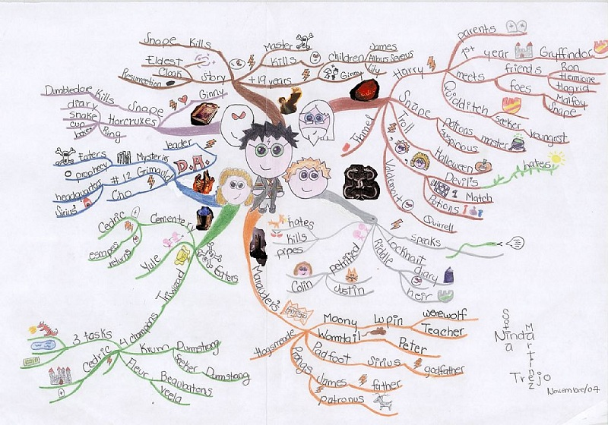
Example Mind Map – Harry Potter
Copyright 2013 Online Teaching Resources Ltd
Notes:
89
Harry Potter mindmap

Slide 90
Lesson - Themes
Learning Question
  What are the main themes of the novel?
  What is the message that Stevenson is trying to get across?

Slide 91
The Duality of Human Nature
The title of the novel is now a part of our common language and can even be found in some dictionaries. Encarta defines ‘Jekyll and Hyde’ as ‘Someone seeming to have two different personalities. someone who seems to have two different characters, one good and one bad’ and it is often used to describe a person with a dual personality.
In Chapter 10, Jekyll writes about the dual nature of human beings. He says that, as a young, educated man from a respectable family, he maintained an appearance of good behaviour at all times. But he says this was a fraud - no one suspected his true nature, which was at times extremely immoral.
Jekyll's experiments began in an attempt to separate the two sides of human nature and destroy the evil one. He discovered that the evil part of his nature was, indeed, part of himself, and therefore, in some sense, natural and part of the whole. Jekyll was unable to destroy the evil side of his nature, instead he indulged it and it destroyed the good in him.
Copyright 2013 Online Teaching Resources Ltd

Slide 92
Science and the Supernatural
The story contains two doctors, each the complete opposite to the other and each representing different viewpoints and beliefs. Throughout the Victorian era traditional scientific thought and philosophy explained the real world through experiment and observation. Scientists are usually dismissive of the supernatural, and Lanyon has avoided Jekyll for ten years because of his 'fanciful' and 'wrong minded' ideas.
Jekyll is an unconventional scientist reminiscent of Mary Shelley’s Dr Frankenstein, a major influence on the themes and characters of Jekyll and Hyde. Jekyll’s experiments are ‘mystic’ and ‘transcendental". He is fascinated by the secrets and enigmas of life and the universe and is more philosophical and mystical than traditional 19th-century science.
It is significant that both Jekyll and Lanyon die in the story, each one destroyed by their unshakable beliefs. Lanyon by his incapacity to accept a world beyond the rational and scientific; Jekyll by accepting and unleashing the evil within his soul.
Stevenson does not come down on one side or the other but instead asks us to consider for ourselves which is closer to the truth.
Copyright 2013 Online Teaching Resources Ltd

Slide 93
Reason and the Unexplained
Utterson is a lawyer and therefore he represents the rules and regulations of conventional society and the law. He is more like Lanyon than Jekyll and does not believe in the supernatural.
Uttersons scepticism is the main reason why Jekyll cannot confide in him, even though they are old friends. Utterson is a good and well meaning man but his rationalism blinds him to the truth. Every time Utterson uncovers a fresh piece of evidence he comes to the wrong conclusions. As a lawyer he constantly suspects Hyde is blackmailing Jekyll or has some other criminal purpose.
The ultimate failure of Utterson (and therefore the law of reason) is evident at the end of the novel. At the end of Chapter 8, The Last Night, Utterson states that "I shall be back before midnight, when we shall send for the police." But neither he nor the police (another symbol of the law) are heard of again. The law cannot explain the Strange Case of Dr Jekyll and Mr Hyde.
Copyright 2013 Online Teaching Resources Ltd

Slide 94
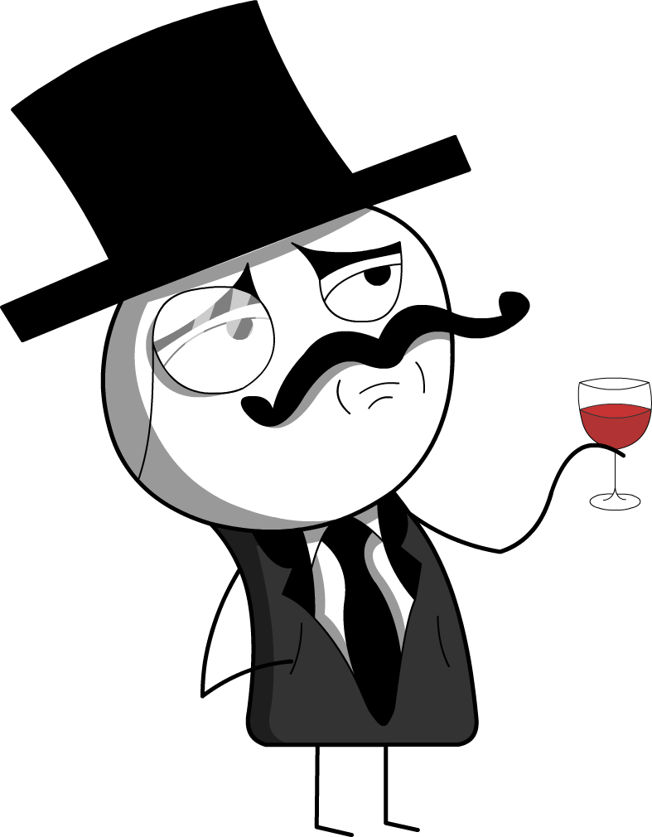
Reputation
Reputation is very important to the gentlemen in the novel. Immoral activities and uncontrolled emotions would damage a gentleman’s reputation. If this happened, they may no longer be seen as a gentleman at all, which would mean losing many social advantages. This means that the gentlemen in Jekyll and Hyde value their reputations above all else.
Utterson is wary of gossip, in case it reflects badly on him or his friends. He and Enfield agree never to talk about Hyde, and believe in not asking questions if something “looks like Queer Street.” Utterson is also more concerned with preserving Jekyll’s reputation than bringing Hyde to trial. After Carew’s murder, he says to Jekyll, “If it came to a trial, your name might appear.”
Stevenson’s message is that reputation cannot be trusted because they are based on appearances. They are the version of a person that he or she wants the world to see.
When a society values reputation as highly as the Victorians did, it makes it difficult to know what people are really like. This is what causes Utterson problems – he cannot fully understand Jekyll’s situation because he only sees Jekyll’s reputation as important. This means that he holds onto the idea of blackmail until the very last moment – he finds it hard to look beyond his concern for reputation.
Copyright 2013 Online Teaching Resources Ltd

Slide 95
Secrecy
The gentlemen in Jekyll and Hyde are a pretty secretive bunch, even though they’re supposed to be friends.
The whole plot of the novel revolves around Jekyll’s secret alter ego, but other characters also have secrets:
Utterson has done “many ill things,” in his past, but he doesn’t say what these things are. This makes his actions appear shameful, even though his past is “fairly blameless.”
It’s never explained where Enfield was returning from at three o’clock in the morning. This makes the reader likely to assume that he was somewhere scandalous.
Stevenson’s narrative has many gaps – this makes the reader more suspicious of things that are left unspoken or unexplained.
Many things are left unsaid. The gentlemen characters often decide not to speak about unpleasant things so they can pretend they’re not happening. They also downplay shocking events, for example Enfield describes the trampled girl as a “bad story” and when Lanyon says he regards Jekyll as dead, Utterson’s only reply is “tut-tut.” this understatement shows the gentlemen are determined to pretend everything is normal.
Both Lanyon and Jekyll choose to write about their experiences, rather than speak about them. These letters are left unread until the end of the novel, which adds to the secrecy and suspense.
Locked doors – hidden secrets
There are many closed doors and windows in the novel:
The back door to Jekyll’s house has “neither bell nor knocker” and it’s associated with Hyde.
Jekyll slams the window shut on Utterson and Enfield, and later locks himself in the cabinet.
Important items, like letters and Jekyll’s ingredients, are kept securely locked in drawers and safes.
These closed doors and windows represent people’s desire to hide their secrets, so smashing the cabinet door is a symbolic moment. It represents the breakdown of Jekyll’s walls of secrecy.
Copyright 2013 Online Teaching Resources Ltd

Slide 96
Lesson – Deeper Understanding
Learning Question:
  What do I know and understand about Stevenson’s use of setting, symbolism and narrative technique?

Slide 97
Setting and Style
The story is set in London at the time it was written – 1886 and Stevenson uses the city to create mood and to explore themes. In the opening chapter as Enfield and Utterson walk through the London streets we see the two contrasting sides of the city; one is modern, affluent and respectable whereas other parts of the city are filthy, poverty stricken and dens of criminality and violence. Edward Hyde lives in Soho, a poor and dangerous part of the affluent West End of London, while Jekyll’s house looks respectable from the front it has a hidden back door which opens onto a dark alley where Hyde comes and goes. This represents Jekyll himself – presenting a façade of middle class respectability which hides the immoral activity that happens when he slips out of the back door as Hyde.
Stevenson uses vivid description of the misty, dreary London to enhance the dark mood of the story and to add tension into certain scenes. The fog is so dense that is covers whole street, amking them places of secrecy. Fog also symbolises mystery. For example, the lecture theatre at Jekyll’s house is described as “foggy.” the fact that the fog seems to have come indoors represents how deeply Jekyll has hidden his secret.
Copyright 2013 Online Teaching Resources Ltd

Slide 98
Symbolism – Keys, Doors and Windows
Symbolism is evident throughout the story, from the London streets to the characters themselves many elements of The Strange Case of Dr. Jekyll and Mr Hyde have significant meanings.
As we have already discussed, Stevenson used the London cityscape to convey themes of respectability and criminality, good and evil and wealth and poverty living side by side and he uses the characters of Henry Jekyll and Edward Hyde to personify the two very different sides of human nature. However, there are many more symbols evident in the story.
Images of keys, windows and doors appear throughout the story. In Chapter One the key used by Hyde is emphasised by Stevenson when he enters the hidden doorway, and we often are presented with locked doors, characters looking through windows and hidden entrances. Such images symbolise transformation and most are connected with the fate of Henry Jekyll. In Chapter One, Hyde has a key to Jekyll’s house which allows him to leave and enter the property without being seen. Utterson is constantly ‘locked out’ by Jekyll both metaphorically and physically when he refuses to see him and hides in the laboratory. Jekylls’ Will and Lanyon’s letter – both providing clues to the mystery are locked away in Utterson’s safe and in Chapter 7 Jekyll, detached from his friends only speaks to them through the upstairs window or from behind a door. The only person in the story with a key is Hyde – who is himself the key to the mystery - the mystery which Utterson only solves when he breaks down the door of Jekyll’s laboratory.
Copyright 2013 Online Teaching Resources Ltd

Slide 99
Symbolism – Place and Weather
Just as Jekyll’s house symbolises the man himself with its pleasant front façade but ugly and derelict rear, other places tell us more about characters, add drama to the story and explore and reinforce themes. Utterson and Lanyon’s houses are neat, clean and ordered whilst Jekyll’s laboratory is described as neglected and chaotic and Hyde’s Soho house is filthy and unloved. Again these images reveal character but also emphasise the themes of contrast and the duality of humanity.
A dark and brooding atmosphere is set by the use of pathetic fallacy in which Stevenson describes the weather. It is often cold, dark or foggy. This not only sets an appropriate atmosphere for an urban gothic story but also reiterates the darkness that Jekyll and Hyde dwell in and the fog that Utterson cannot see through as he tries to solve the mystery.
Copyright 2013 Online Teaching Resources Ltd

Slide 100
Narrative methods
It’s really important to write about structure, because Stevenson uses it to build tension. Most of the story is a third-person narrative, which follows Utterson. The narrative is limited – Utterson finds things out gradually and only learns the truth at the very end. This distance the reader from the truth, creating tension and intrigue. The main narrative follows Utterson experiences in chronological order. This gives a sense of time passing, increasing tension as time goes on. The last two chapters do not follow a linear structure. Instead, they return to explain previous events. By leaving these key explanations until the very end of the novel, Stevenson keeps the reader in suspense throughout.
Stevenson uses several embedded narratives in the novel. These include written documents and testimonies, such as Enfield’s story, the maid’s account of the murder and the letters from Lanyon and Jekyll. These narratives are pieces of evidence in the case. By including them, Stevenson makes the story more realistic, which in turn makes it more frightening. The embedded narratives are also devices to add to the reader’s curiosity. Like a jigsaw, all of the pieces are needed to work out the full picture.
Stevenson uses a first-person narrative for Jekyll’s statement, because Jekyll is the only character that know the whole truth. This gives the reader direct access to his thoughts and feelings.

Slide 101
Jekyll and Hyde as a Gothic Novel
Gothic novels often deal with human emotion, mystery and supernatural goings-on:
In Gothic novels, a double is a pair of characters. Sometimes these are two separate people, such as Dr. Frankenstein and his monster, but sometimes they’re two sides of the same person, such as Jekyll and Hyde.
Mysterious settings | Stevenson’s descriptions of dark, deserted London streets, the “fogged city moon” and the objects in Jekyll’s laboratory are all mysterious.
Disturbing secrets | Jekyll’s secret alter ego is disturbing – Hyde commits horrific crimes and inspires terror in everyone who meets him.
Dreams and visions | Utterson has a terrifying vision in which he is “haunted” by a faceless figure. It’s frightening mixture of Enfield’s story and Utterson’s own fears.
The supernatural | Jekyll’s scientific experiements are “mystic and the trancendental.” Lanyon describes Hyde’s transformation in a way that seems impossible – his features “seemed to melt and alter.” This suggests that Hyde isn’t part of this world.
The double | The novel rests on the idea of man’s double nature. As well as Jekyll’s obvious duality, other characters and settings have two sides.

Slide 102
Questions
1. Find a quote from the novel where the streets in London are described as:
  A) foggy
  B) empty
  C) dark
2. Give one example (a quote) of an object from the novel that has symbolic meaning and explain what it is symbolic of and why.
3. Find a quote the shows that the setting of Jekyll and Hyde is mysterious.

Slide 103
Lesson – Exam Preparation
Learning Question:
  What do I need to keep in mind to create the best possible exam response?

Slide 104
Preparation is important
It’s important to cover all aspects of the text in your revision. You need to make sure you understand the text’s plot, characters, themes and the writer’s techniques.
In the exam, you’ll need to bring together you ideas about these topics to answer the question quickly and effectively.
To revise, think about the different characters and themes in the text, and write down some key points and ideas about each one. Then find some evidence to support each point.

Slide 105
Exam questions
Read the question carefully and underline key words
Read all of the instructions carefully.
Look at the total number fo marks each question is worth and plan your time accordingly.
Read the question at least twice so you completely understand it. Underline the key words which you can use to guide your extract annotation.

Slide 106
Example question
‘How’ questions ask you to think about the writer’s techniques. E.g. Stevenson’s use of setting and symbolism.
Remember to write about form, structure and language.
How does Stevenson present the theme of secrecy in the extract?
Secrecy is a key theme – use a range of examples to support your answer.
You must refer to and quote from the extract in your answer.

Slide 107
Know the exam language
Some words come up regularly in exam questions. Make sure you understand what they mean.
Question Word | You need to...
Explore/Explain | Show how the writer deals with a theme, character or idea. Make several different points to answer the question.
How does | Think about the techniques or literary features that the author uses to get their point across.
Give examples | Use direct quotes and describe events from the text in your own words.
Refer to | Read the question so that you know if you need to write about just an extract, or an extract and the rest of the text.

Slide 108
Plan your answer
You always need to plan your answer before you start. If you plan, you’re less likely to forget something important.
A good plan will help you organise your ideas and write a good, well structured response.
Don’t spend too long on your plan. It’s only rough work, so you don’t need to write in full sentences.

Slide 109
Here are a few examples of different ways you can plan your answer.
Bullet points
Introduction...
An idea...
The next idea...
Another idea...
Yet another idea...
Conclusion...
Intro
An idea
Spider diagram
Conclusion
More ideas
Another idea

Slide 110
Introductions and conclusions
Key Tip
Use the questions words in your introduction and conclusion. This will help to keep the question fresh in your mind, and show the examiner that you are answering the question.
Introduction
  Get to the point straight away in your introduction
  Begin by giving a clear answer to the question in one or two sentences.
  Use the rest of the introduction to explain exactly what you’re going to be analysing, without giving too much detail.
Conclusion
  Your conclusion must answer the question
  It’s your last chance to persuade the examiner, so make your main point again.
  Use your last sentence to really impress the examiner – make it stand out.

Slide 111
Main paragraphs
PEAL is how to put your argument together.
Use short quotes to support your ideas
  Utterson’s face is “never lighted by a smile” because he represses his emotions. As a model Victorian gentleman, he needs to appear respectable at all times, which means hiding any emotions he thinks might be judged as unseemly.
It can be more effective to use short, embedded quotes as evidence. Then you can go on to seamlessly explain them.

Slide 112
Try it
‘How does Stevenson present the theme of secrecy in the novel?’
For this task you may choose a section of the novel to examine, but be clear about what section you’re doing. In the exam expect to be given an extract, you won’t have a choice.
Write out the question, break it down (underline key words) and make a plan -> consider including quotes in your plan.

Slide 113
Lesson – Exam questions
Learning Question:
  How do I breakdown and respond to exam questions?

Slide 114
Exam Question Breakdown
Read the question carefully, underline the important bits.
Write about context – how Hyde’s behaviour would have been particularly disturbing to upper-class Victorians.
Explore how Stevenson presents Hyde’s character in this extract.

Slide 115
Find the key words and phrases
Think about how Stevenson uses language and dialogue to present the character of Mr. Hyde.
You need to think about how Hyde is presented specifically in this extract. E.G. His actions, his appearance and other characters’ reactions to him.
Explore how Stevenson presents Hyde’s character in this extract.
You’ll need to discuss the passage given, in detail.

Slide 116
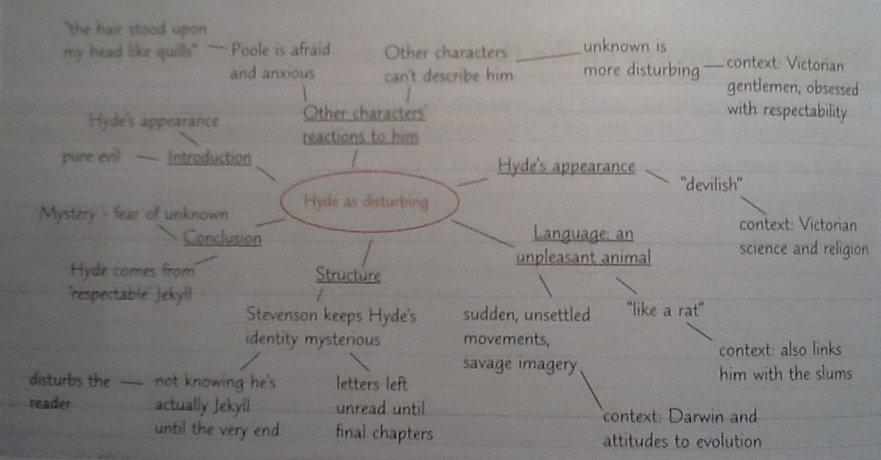
Example plan

Slide 117
Introduction
It’s a good idea to use the key words in the question to give your response focus and show the examiner that you’re on the right track and that you’re thinking about the question from the start.
‘Stevenson uses a number of different techniques to present Hyde as a disturbing character in the extract: his appearance is startling, his movements are unsettling, and he is associated with the hidden dark side of Victorian society. Hyde has a disturbing presence because he is purely evil character with no redeeming features. This makes him seem inhuman because nature is made up of a balance of good and bad qualities.’
This intro links your response to the themes, indicating that you have a thorough knowledge of the text.
This tells the examiner what your essay response is about and shows that you’ve thought about your response structure.

Slide 118
Developing your paragraphs
Start by introducing the main point of your paragraph.
‘Stevenson uses other characters’ reactions to Hyde to demonstrate that he is a disturbing character. Poole is left afraid and anxious after his sighting of Hyde, and he is unable to finish the sentence that he begins with “And then...”. This shows that his fear and confusion after seeing Hyde are strong enough to make him inarticulate. Similarly, Lanyon states that Hyde is “not easy to describe” and says that he can’t “specify the point” about why Hyde is so unsettling. Stevenson is using these characters’ reactions to suggest that Hyde is so disturbing that he’s impossible to describe. The presentation of Hyde is particularly unnerving because he inspires deep-seated feelings of disgust and hatred in those who meet him, and yet this is not solely because of his appearance. There is something unnatural and frightening about Hyde that is impossible to identify and explain.’
Use evidence from the extract to back up your point. Then show how it links to the rest of the text.
Explain how your evidence supports your original point.
Finally, develop your point by analysing the effect of Stevenson’s writing on the reader.

Slide 119
Link it to the themes
‘Stevenson uses animalistic language to make Hyde seem disturbing. Poole describes him as “like a rat” and portrays him as “digging among the crates” and giving a “kind of cry”. This animalistic imagery suggests that Hyde is savage and less civilized than Jekyll, a reputable, upper-class gentleman. This links to the wider theme that all humans have a dual nature: there’s a constant struggle between the good, civilized side and the darker, more primitive side of man. Hyde’s character is disturbing because it forces the reader to confront the frightening idea that they have a version of Mr. Hyde within them.’
It’s a good idea to show the examiner you’re aware of how the extract displays the themes of the novel.
Don’t forget to explain how your point links to the exam question

Slide 120
This is worth 20 marks – don’t be lazy!
Make the conclusion stand out!
This shows that you’ve considered all the techniques Stevenson used
‘Hyde is a disturbing character because he represents the evil side of human nature. This is demonstrated by Stevenson in various ways, including his use of animalistic language to describe Hyde and his depictions of other characters inarticulate and repulsed reactions to Hyde. Hyde is capable of extreme cruelty, and the fact that his evil nature originates from Jekyll, a respectable gentleman, is highly disturbing. Hyde’s wickedness hints at something beyond our understanding, which is truly frightening.
Make your last sentence really stand out – it’s your last chance to impress the examiner.
If you can’t imagine dropping the mic after your last sentence, it’s not strong enough.

Slide 121
Lesson
Practice Assessment

Slide 122
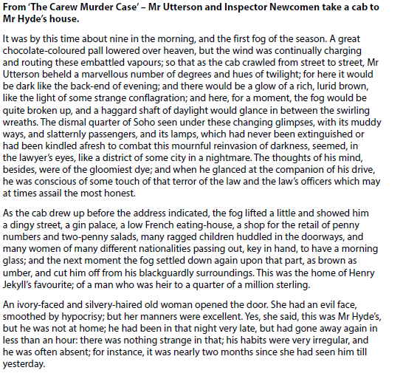

Slide 123
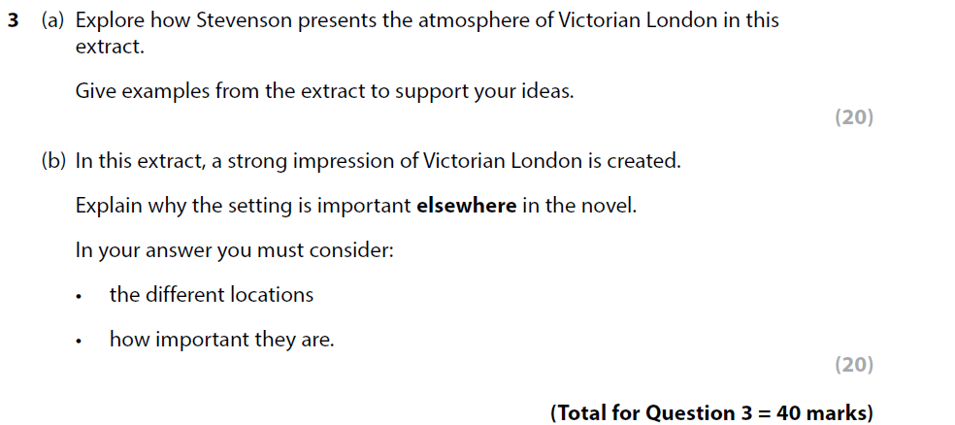
Questions

Slide 124
Lesson – Review your responses
Learning Question:
  What could I have used in my response to make it stronger?
  What do I need to improve in my response?

Slide 125
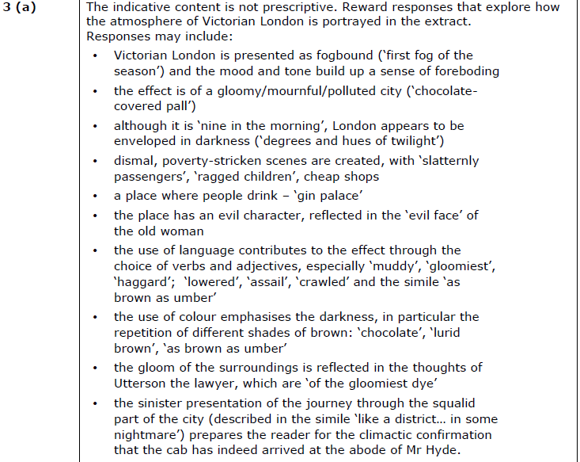
What you could have used for 3a

Slide 126
Did you use your time effectively?
Grab 3 highlighters: 1 for Point, 1 for Evidence, 1 for Analysis.
Go through your response and highlight your point, evidence and analysis in their correct colours.
BUT! You can ONLY highlight the sentences that are effective and contributing to your answer. You are going to end up with some sentences that can’t be highlighted because they don’t usefully link to your point or make sense with your evidence.
That means you WAFFLED!!!

Slide 127
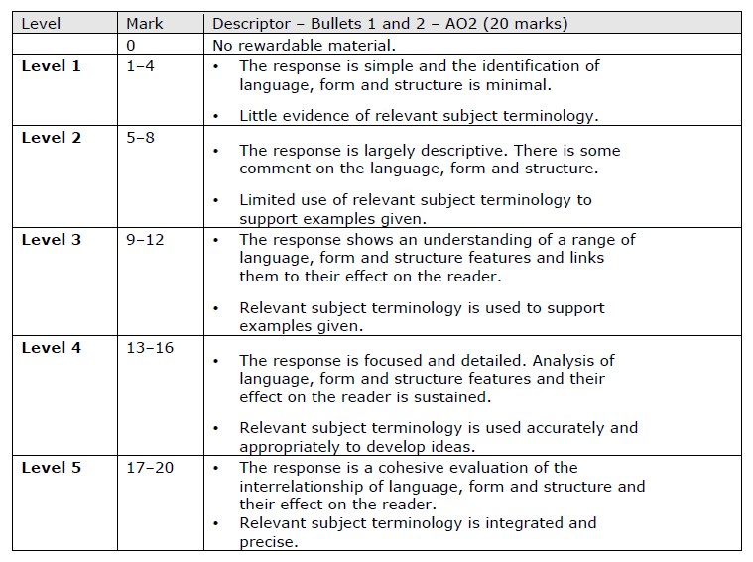
Did you do everything you needed to? What mark would you give yourself? Be honest.

Slide 128
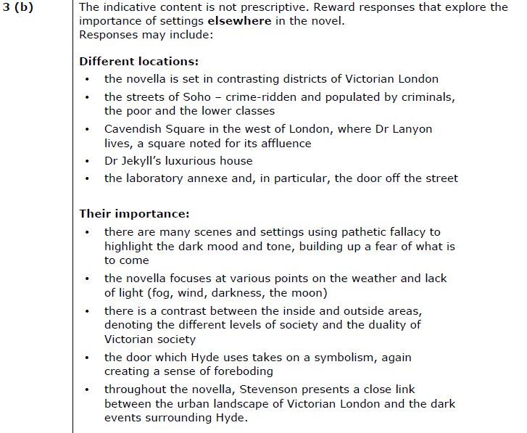
What you could have used or 3b

Slide 129
Repeat the process
Grab those highlighters again
Don’t be afraid to be BRUTAL on yourself with your responses – trust me, the examiners aren’t afraid to be.
If you catch your waffling now, you may be able to stop yourself from doing it in your exam.

Slide 130
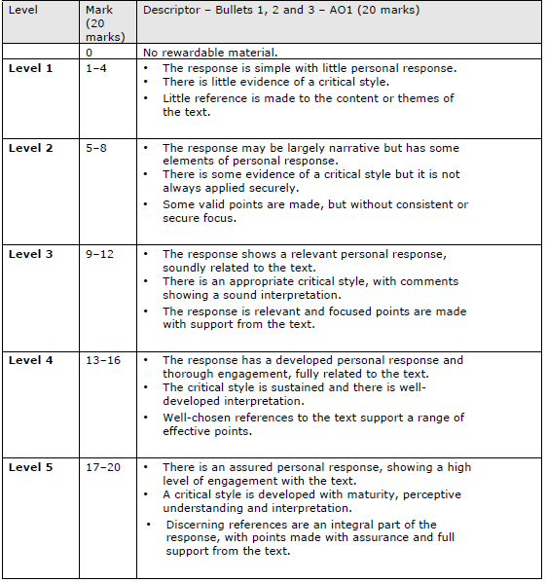
Did you do everything you needed to? What mark would you give yourself? Be honest.

Slide 131
Homework
Take your responses home and re-write them.
All the mistakes you found, fix them! Get rid of all that WAFFLING!
Figure out how to improve your responses now, so you can do it the first time in your exam.

