Slide 1
Entrance task:
What is an opinion?
Does everyone have the right to express their opinion?
Why/why not?

Slide 2
Entrance task:
What is an opinion?
Does everyone have the right to express their opinion?
Why/why not?
We have laws to protect people from hate speech:
Expressions of hatred toward someone on account of that person's colour, race, nationality (including citizenship), ethnic or national origin, religion, or sexual orientation is illegal.
Any communication which is threatening or abusive, and is intended to harass, alarm, or distress someone is illegal.
The penalties for hate speech include fines, imprisonment, or both.
However, you still have a right to express your opinion as long as it is not considered a hate act.

Slide 3
Introducing the exam unit
English Language GCSE Paper 2: Writer’s Viewpoints and Perspectives
Section B: Writing to present a viewpoint
LO:
To develop an understanding of the requirements for the GCSE English Language section 2B
To create a piece of writing based on people talking about themselves

Slide 4
Talking about yourself
People have always enjoyed writing and talking about themselves and their experiences.
Why do you think we like talking about ourselves?
What methods do people use to communicate information about themselves?
Why are social networking sites and reality TV programmes so popular?

Slide 5
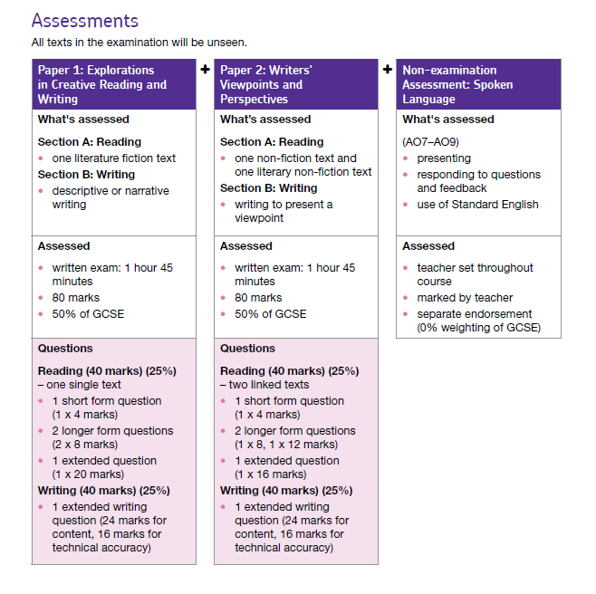

Slide 6
Assessment Objective 5 and 6
Assessment Objectives
AO5 AO6
Communicate clearly, effectively and imaginatively, selecting and adapting tone, style and register for different forms, purposes and audiences.
Organise information and ideas, using structural and grammatical features to support coherence and cohesion of texts.
Use a range of vocabulary and sentence structures for clarity, purpose and effect, with accurate spelling and punctuation.
60%
40%

Slide 7
Assessment Objective 5 and 6
Assessment Objectives
AO5 AO6
Re-write these AOs in your own words so that they make sense. This can be in note form, bullet points or full sentences.
Communicate clearly, effectively and imaginatively, selecting and adapting tone, style and register for different forms, purposes and audiences.
Organise information and ideas, using structural and grammatical features to support coherence and cohesion of texts.
Use a range of vocabulary and sentence structures for clarity, purpose and effect, with accurate spelling and punctuation.

Slide 8
What should/shouldn’t you share?
In pairs, create a list of things that you think are ok to share and a list of things that you should not share.
This can be a serious or a funny list!

Slide 9
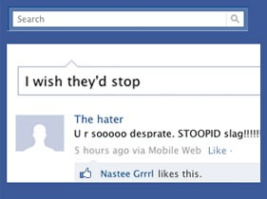
The downside of the internet...

Slide 10
Don’t get me started on the internet...
Don’t get me started on Twitter. 140 characters of banality. I don’t care what you had for lunch. You had breakfast and then you went to school? Well, at least you are doing things in the correct order. You hate your job? Your boss will be thrilled to hear that, particularly as you are still on probation. Welcome to the world of random oversharing, where no piece of information is too small or private...

Slide 11
What’s your opinion on...
Facebook status updates
Twitter
YouTube/Vlogging
Selfies
Instagram
Snapchat
Choose one and create a humorous opinion piece

Slide 12
Plenary
Share your ideas with the class

